Slide 1

Microprocessors final project
Paul Patullo and Lukas Kelk

Slide 2
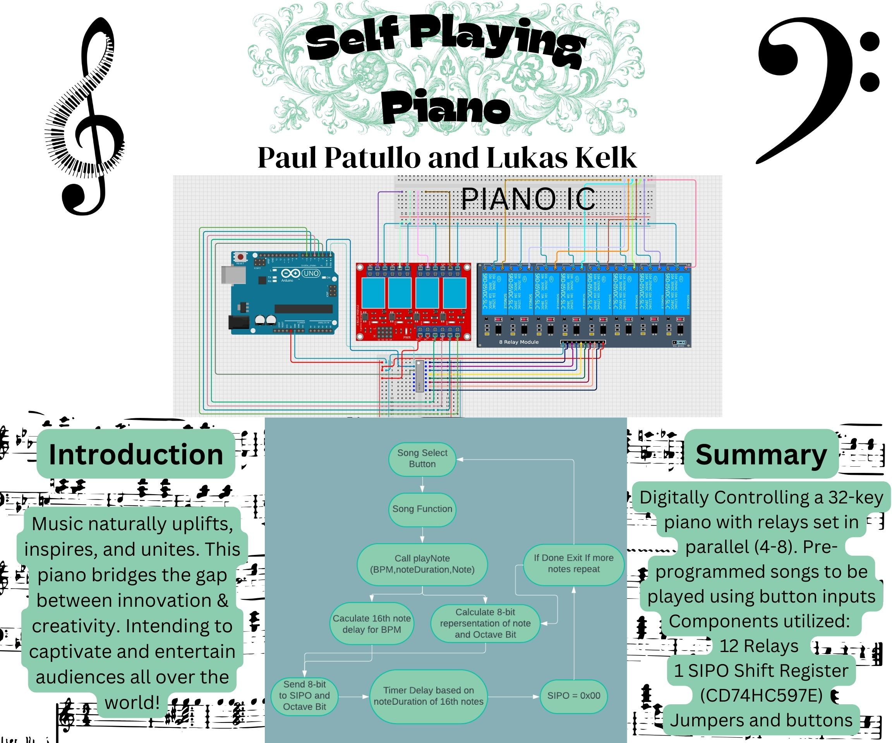

Slide 3
#include <avr/io.h>
#define F_CPU 16000000UL
#include "util/delay.h"
#include <avr/interrupt.h>
#include <string.h> char HALF = 8;
char QUARTER = 4;
char EIGHT = 2;
char SIXTEENTH = 1;
char THIRTYSECONDTH = .5;
void custom_delay_ms(unsigned int ms) {
unsigned int i;
for (i = 0; i < ms; i++) {
_delay_ms(1); // Use built-in delay function for 1 millisecond
}
}

Slide 4
void custom_delay_ms(unsigned int ms) {
unsigned int i;
for (i = 0; i < ms; i++) {
_delay_ms(1); // Use built-in delay function for 1 millisecond
}
}
void shiftOutPORTD(char DATAP, char CLKP, char data){
for (char i = 0; i < 8; i++) {
// Output the current bit on the data pin
if (data & (1 << (7 - i))) {
PORTD |= (1 << DATAP); // Set data pin high
} else {
PORTD &= ~(1 << DATAP); // Set data pin low
}
// Pulse the clock pin to shift the next bit
PORTD |= (1 << CLKP); // Set clock pin high
PORTD &= ~(1 << CLKP); // Set clock pin low
}
}

Slide 5
void shiftRegisterDisplay(char bar){
//data pin SER (1<<0);
//update clock latch SRCLK (1<<1);
//Output pin RCLK (1<<2);
PORTD &= ~(1 << 1); // CLKP low
PORTD &= ~(1 << 2); // RCLK low
PORTD &= ~(1<<2);
shiftOutPORTD(0,1,bar);
PORTD |= (1<<2);
}

Slide 6
void playNote(float BPM,char noteDuration, char note){
char shift;
char octave;
switch(note){
case 0: shift = 0; octave = 0; break;
case 1: shift = 1; octave = 0; break;
case 2: shift = 2; octave = 0; break;
case 3: shift = 3; octave = 0; break;
case 4: shift = 4; octave = 0; break;
case 5: shift = 5; octave = 0; break;
case 6: shift = 6; octave = 0; break;
case 7: shift = 7; octave = 0; break;
case 8: shift = 0; octave = 1; break;
case 9: shift = 1; octave = 1; break;
case 10: shift = 2; octave = 1; break;
case 11: shift = 3; octave = 1; break;
case 12: shift = 4; octave = 1; break;
case 13: shift = 5; octave = 1; break;
case 14: shift = 6; octave = 1; break;
case 15: shift = 7; octave = 1; break;
case 16: shift = 0; octave = 2; break;
case 17: shift = 1; octave = 2; break;
case 18: shift = 2; octave = 2; break;
case 19: shift = 3; octave = 2; break;
case 20: shift = 4; octave = 2; break;
case 21: shift = 5; octave = 2; break;
case 22: shift = 6; octave = 2; break;
case 23: shift = 7; octave = 2; break;
case 24: shift = 0; octave = 3; break;
case 25: shift = 1; octave = 3; break;
case 26: shift = 2; octave = 3; break;
case 27: shift = 3; octave = 3; break;
case 28: shift = 4; octave = 3; break;
case 29: shift = 5; octave = 3; break;
case 30: shift = 6; octave = 3; break;
case 31: shift = 7; octave = 3; break;
case 32: shift = 10; octave = 10; break;
default: shift = 0; octave = 0;
}

Slide 7
float n = ((60000.0 / BPM) / 4) * noteDuration; // Calculate total duration in milliseconds
PORTD |= (1<<(octave+3));
shiftRegisterDisplay(1<<shift);
custom_delay_ms(n/2); // don't remove the delay
PORTD &=~(1<<(octave+3));
shiftRegisterDisplay(0);
custom_delay_ms(n/2);
}

Slide 8
playNote(BPM,QUARTER,10);
playNote(BPM,QUARTER,8);
playNote(BPM,QUARTER,7);
playNote(BPM,QUARTER,5);
playNote(BPM,QUARTER,3);
playNote(BPM,QUARTER,3);
playNote(BPM,QUARTER,5);
playNote(BPM,QUARTER,7);
playNote(BPM,QUARTER+EIGHT,5);
playNote(BPM,EIGHT,3);
playNote(BPM,QUARTER+QUARTER,3);
}
void OdeToJoy(float BPM) {
playNote(BPM,QUARTER,7);
playNote(BPM,QUARTER,7);
playNote(BPM,QUARTER,8);
playNote(BPM,QUARTER,10);
playNote(BPM,QUARTER,10);
playNote(BPM,QUARTER,8);
playNote(BPM,QUARTER,7);
playNote(BPM,QUARTER,5);
playNote(BPM,QUARTER,3);
playNote(BPM,QUARTER,3);
playNote(BPM,QUARTER,5);
playNote(BPM,QUARTER,7);
playNote(BPM,QUARTER+EIGHT,7);
playNote(BPM,EIGHT,5);
playNote(BPM,QUARTER+QUARTER,5);
playNote(BPM,QUARTER,7);
playNote(BPM,QUARTER,7);
playNote(BPM,QUARTER,8);
playNote(BPM,QUARTER,10);

Slide 9
playNote(BPM,QUARTER,5);
playNote(BPM,QUARTER,5);
playNote(BPM,QUARTER,7);
playNote(BPM,QUARTER,3);
playNote(BPM,QUARTER,5);
playNote(BPM,EIGHT,7);
playNote(BPM,EIGHT,8);
playNote(BPM,QUARTER,7);
playNote(BPM,QUARTER,3);
playNote(BPM,QUARTER,5);
playNote(BPM,EIGHT,7);
playNote(BPM,EIGHT,8);
playNote(BPM,QUARTER,7);
playNote(BPM,QUARTER,5);
playNote(BPM,QUARTER,3);
playNote(BPM,QUARTER,5);
playNote(BPM,QUARTER+QUARTER,10);
playNote(BPM,QUARTER,7);
playNote(BPM,QUARTER,7);
playNote(BPM,QUARTER,8);
playNote(BPM,QUARTER,10);
playNote(BPM,QUARTER,10);
playNote(BPM,QUARTER,8);
playNote(BPM,QUARTER,7);
playNote(BPM,QUARTER,5);
playNote(BPM,QUARTER,3);
playNote(BPM,QUARTER,3);
playNote(BPM,QUARTER,5);
playNote(BPM,QUARTER,7);
playNote(BPM,QUARTER+EIGHT,5);
playNote(BPM,EIGHT,3);
playNote(BPM,QUARTER+QUARTER,3);
}

Slide 10
void FurElise(float BPM) {
playNote(BPM,EIGHT,24);
playNote(BPM,EIGHT,23);
playNote(BPM,EIGHT,24);
playNote(BPM,EIGHT,23);
playNote(BPM,EIGHT,24);
playNote(BPM,EIGHT,19);
playNote(BPM,EIGHT,22);
playNote(BPM,EIGHT,20);
playNote(BPM,EIGHT,17);
playNote(BPM,QUARTER,32);
playNote(BPM,EIGHT,8);
playNote(BPM,EIGHT,12);
playNote(BPM,EIGHT,17);
playNote(BPM,EIGHT,19);
playNote(BPM,QUARTER,32);
playNote(BPM,EIGHT,12);
playNote(BPM,EIGHT,16);
playNote(BPM,EIGHT,19);
playNote(BPM,EIGHT,20);
playNote(BPM,QUARTER,32);
playNote(BPM,EIGHT,12);
playNote(BPM,EIGHT,24);
playNote(BPM,EIGHT,23);
playNote(BPM,EIGHT,24);
playNote(BPM,EIGHT,23);
playNote(BPM,EIGHT,24);
playNote(BPM,EIGHT,19);
playNote(BPM,EIGHT,22);
playNote(BPM,EIGHT,20);
playNote(BPM,EIGHT,17);
playNote(BPM,QUARTER,32);
playNote(BPM,EIGHT,8);
playNote(BPM,EIGHT,12);
playNote(BPM,EIGHT,17);
playNote(BPM,EIGHT,19);
playNote(BPM,QUARTER,32);
playNote(BPM,EIGHT,12);
playNote(BPM,EIGHT,20);
playNote(BPM,EIGHT,19);

Slide 11
playNote(BPM,EIGHT,17);
playNote(BPM,QUARTER,32);
playNote(BPM,EIGHT,19);
playNote(BPM,EIGHT,20);
playNote(BPM,EIGHT,22);
playNote(BPM,EIGHT,24);
playNote(BPM,QUARTER,32);
playNote(BPM,EIGHT,15);
playNote(BPM,EIGHT,25);
playNote(BPM,EIGHT,24);
playNote(BPM,EIGHT,22);
playNote(BPM,QUARTER,32);
playNote(BPM,EIGHT,13);
playNote(BPM,EIGHT,24);
playNote(BPM,EIGHT,22);
playNote(BPM,EIGHT,20);
playNote(BPM,QUARTER,32);
playNote(BPM,EIGHT,12);
playNote(BPM,EIGHT,22);
playNote(BPM,EIGHT,20);
playNote(BPM,EIGHT,19);
playNote(BPM,EIGHT,32);
playNote(BPM,EIGHT,12);
playNote(BPM,EIGHT,24);
playNote(BPM,EIGHT,12);
playNote(BPM,EIGHT,24);
playNote(BPM,EIGHT,12);
playNote(BPM,EIGHT,24);
playNote(BPM,EIGHT,12);
playNote(BPM,EIGHT,24);
playNote(BPM,EIGHT,12);
playNote(BPM,EIGHT,32);
playNote(BPM,EIGHT,24);
playNote(BPM,EIGHT,23);
playNote(BPM,EIGHT,24);
playNote(BPM,EIGHT,23);
playNote(BPM,EIGHT,24);

Slide 12
playNote(BPM,SIXTEENTH,23);
playNote(BPM,SIXTEENTH,24);
playNote(BPM,SIXTEENTH,23);
playNote(BPM,SIXTEENTH,24);
playNote(BPM,SIXTEENTH,23);
playNote(BPM,SIXTEENTH,24);
playNote(BPM,SIXTEENTH,23);
playNote(BPM,SIXTEENTH,24);
playNote(BPM,SIXTEENTH,23);
playNote(BPM,SIXTEENTH,24);
playNote(BPM,QUARTER,19);
playNote(BPM,QUARTER,22);
playNote(BPM,QUARTER+QUARTER,20);
playNote(BPM,QUARTER+QUARTER,17);
playNote(BPM,QUARTER+QUARTER,5);
}

Slide 13
void PartyInUSA(float BPM){
playNote(BPM,QUARTER,8);
playNote(BPM,QUARTER,13);
playNote(BPM,EIGHT,13);
playNote(BPM,EIGHT,13);
playNote(BPM,QUARTER,8);
playNote(BPM,QUARTER,8);
playNote(BPM,EIGHT,6);
playNote(BPM,QUARTER,6);
playNote(BPM,QUARTER,5);
playNote(BPM,EIGHT,5);
playNote(BPM,EIGHT,5);
playNote(BPM,EIGHT,5);
playNote(BPM,QUARTER,5);
playNote(BPM,EIGHT,5);
playNote(BPM,EIGHT,5);
playNote(BPM,QUARTER,5);
playNote(BPM,EIGHT,1);
playNote(BPM,QUARTER+EIGHT,3);
playNote(BPM,QUARTER,32);
playNote(BPM,EIGHT,13);
playNote(BPM,EIGHT,13);
playNote(BPM,EIGHT,13);
playNote(BPM,EIGHT,13);
playNote(BPM,QUARTER,8);
playNote(BPM,QUARTER,8);
playNote(BPM,EIGHT,6);
playNote(BPM,QUARTER,6);
playNote(BPM,EIGHT,5);
playNote(BPM,QUARTER,32);
playNote(BPM,EIGHT,5);
playNote(BPM,EIGHT,5);
playNote(BPM,QUARTER,5);
playNote(BPM,EIGHT,5);
playNote(BPM,EIGHT,5);
playNote(BPM,QUARTER,5);
playNote(BPM,EIGHT,1);

Slide 14
playNote(BPM,QUARTER,3);
playNote(BPM,QUARTER+QUARTER,32);
playNote(BPM,QUARTER,13);
playNote(BPM,EIGHT,13);
playNote(BPM,EIGHT,13);
playNote(BPM,QUARTER,13);
playNote(BPM,EIGHT,13);
playNote(BPM,EIGHT,13);
playNote(BPM,QUARTER,12);
playNote(BPM,EIGHT,12);
playNote(BPM,EIGHT,12);
playNote(BPM,QUARTER,12);
playNote(BPM,EIGHT,13);
playNote(BPM,QUARTER,13);
playNote(BPM,EIGHT,13);
playNote(BPM,EIGHT,13);
playNote(BPM,EIGHT,13);
playNote(BPM,QUARTER,13);
}
playNote(BPM,EIGHT,13);
playNote(BPM,EIGHT,13);
playNote(BPM,EIGHT,12);
playNote(BPM,EIGHT,12);
playNote(BPM,EIGHT,12);
playNote(BPM,EIGHT,12);
playNote(BPM,QUARTER,12);
playNote(BPM,QUARTER+QUARTER,13);
playNote(BPM,EIGHT,13);
playNote(BPM,EIGHT,13);
playNote(BPM,EIGHT,13);
playNote(BPM,EIGHT,13);
playNote(BPM,QUARTER,13);
playNote(BPM,QUARTER,13);
playNote(BPM,QUARTER+EIGHT,15);
playNote(BPM,QUARTER,17);
playNote(BPM,QUARTER,32);
playNote(BPM,EIGHT,13);
playNote(BPM,EIGHT,13);
playNote(BPM,EIGHT,13);

Slide 15
playNote(BPM,EIGHT,13);
playNote(BPM,QUARTER,13);
playNote(BPM,QUARTER,13);
playNote(BPM,QUARTER+EIGHT,15);
playNote(BPM,QUARTER,17);
playNote(BPM,QUARTER,32);
playNote(BPM,EIGHT,8);
playNote(BPM,EIGHT,13);
playNote(BPM,EIGHT,13);
playNote(BPM,EIGHT,13);
playNote(BPM,QUARTER,13);
playNote(BPM,EIGHT,13);
playNote(BPM,EIGHT,13);
playNote(BPM,EIGHT,12);
playNote(BPM,EIGHT,12);
playNote(BPM,EIGHT,12);
playNote(BPM,EIGHT,12);
playNote(BPM,EIGHT,12);
playNote(BPM,QUARTER,13);
playNote(BPM,EIGHT,13);
playNote(BPM,EIGHT,13);
playNote(BPM,EIGHT,13);
playNote(BPM,QUARTER,13);
playNote(BPM,EIGHT,13);
playNote(BPM,QUARTER,13);
playNote(BPM,EIGHT,13);
playNote(BPM,EIGHT,13);
playNote(BPM,EIGHT,13);
playNote(BPM,EIGHT,22);
playNote(BPM,EIGHT,20);
playNote(BPM,QUARTER,17);
playNote(BPM,EIGHT,17);
playNote(BPM,EIGHT,17);
playNote(BPM,QUARTER,17);
playNote(BPM,QUARTER,17);
playNote(BPM,QUARTER,17);
playNote(BPM,EIGHT,15);
playNote(BPM,QUARTER+QUARTER,17);

Slide 16
playNote(BPM,EIGHT,13);
playNote(BPM,EIGHT,13);
playNote(BPM,QUARTER,17);
playNote(BPM,QUARTER,17);
playNote(BPM,QUARTER,17);
playNote(BPM,EIGHT,15);
playNote(BPM,QUARTER,15);
playNote(BPM,EIGHT,13);
playNote(BPM,QUARTER+QUARTER,10);
playNote(BPM,EIGHT,13);
playNote(BPM,EIGHT,13);
playNote(BPM,QUARTER,17);
playNote(BPM,QUARTER,17);
playNote(BPM,QUARTER,17);
playNote(BPM,EIGHT,15);
playNote(BPM,QUARTER+QUARTER,17);
playNote(BPM,EIGHT,13);
playNote(BPM,EIGHT,13);
playNote(BPM,EIGHT,13);
playNote(BPM,EIGHT,13);
playNote(BPM,QUARTER+QUARTER,20);
playNote(BPM,QUARTER+QUARTER,17);
playNote(BPM,QUARTER,13);
playNote(BPM,EIGHT,20);
playNote(BPM,EIGHT,20);
playNote(BPM,EIGHT,20);
playNote(BPM,QUARTER,13); playNote(BPM,QUARTER+QUARTER,17);
playNote(BPM,EIGHT,17);
playNote(BPM,EIGHT,17);
playNote(BPM,EIGHT,17);
playNote(BPM,EIGHT,17);
playNote(BPM,QUARTER,17);
playNote(BPM,QUARTER,13);
playNote(BPM,QUARTER+QUARTER,15);
playNote(BPM,EIGHT,13);
playNote(BPM,QUARTER,13);
playNote(BPM,EIGHT,13);
playNote(BPM,QUARTER,13);
playNote(BPM,EIGHT,13);
playNote(BPM,QUARTER+QUARTER,8);

Slide 17
playNote(BPM,EIGHT,13);
playNote(BPM,QUARTER,13);
playNote(BPM,EIGHT,13);
playNote(BPM,QUARTER,13);
playNote(BPM,EIGHT,13);
playNote(BPM,QUARTER+QUARTER,8);
playNote(BPM,EIGHT,13);
playNote(BPM,EIGHT,13);
playNote(BPM,EIGHT,13);
playNote(BPM,EIGHT,13);
playNote(BPM,QUARTER,20);
playNote(BPM,QUARTER,22);
playNote(BPM,EIGHT,20);
playNote(BPM,QUARTER,17);
playNote(BPM,EIGHT,13);
playNote(BPM,EIGHT,17);
playNote(BPM,EIGHT,20);
playNote(BPM,QUARTER+QUARTER,17);
playNote(BPM,EIGHT,8);
playNote(BPM,EIGHT,8);
playNote(BPM,EIGHT,8);
playNote(BPM,EIGHT,8);
playNote(BPM,QUARTER,8);
playNote(BPM,QUARTER,15);
playNote(BPM,QUARTER,13);
playNote(BPM,QUARTER,22);
playNote(BPM,EIGHT,20);
playNote(BPM,QUARTER,17);
playNote(BPM,EIGHT,13);
playNote(BPM,EIGHT,17);
playNote(BPM,EIGHT,20);
playNote(BPM,QUARTER+QUARTER,17);
playNote(BPM,EIGHT,8);
playNote(BPM,EIGHT,8);
playNote(BPM,EIGHT,8);
playNote(BPM,EIGHT,8);
playNote(BPM,QUARTER,8);
playNote(BPM,QUARTER,15);

Slide 18
RUSHE(float BPM){
playNote(BPM,HALF+HALF+HALF+HALF+HALF+HALF+HALF,12);
playNote(BPM,HALF+HALF+HALF+HALF+HALF+SIXTEENTH,12);
playNote(BPM,HALF+HALF+HALF+HALF+QUARTER+SIXTEENTH,12);
playNote(BPM,HALF+HALF+HALF+HALF+QUARTER+EIGHT,12);
playNote(BPM,HALF+HALF+HALF+ HALF+QUARTER,12);
playNote(BPM,HALF+HALF+HALF+EIGHT,12);
playNote(BPM,HALF+HALF+QUARTER,12);
playNote(BPM,HALF+HALF+EIGHT,12);
playNote(BPM,HALF+HALF+EIGHT,12);
playNote(BPM,HALF+HALF+SIXTEENTH,12);
playNote(BPM,HALF+HALF+SIXTEENTH,12);
playNote(BPM,HALF+HALF,12);
playNote(BPM,HALF+HALF,12);
playNote(BPM,HALF+QUARTER,12);
playNote(BPM,HALF+QUARTER,12);
playNote(BPM,HALF+QUARTER,12);
playNote(BPM,QUARTER,12);
playNote(BPM,QUARTER,12);
playNote(BPM,QUARTER,12);
playNote(BPM,QUARTER,12);
playNote(BPM,QUARTER,12);
playNote(BPM,EIGHT,12);
playNote(BPM,EIGHT,12);

Slide 19
playNote(BPM,EIGHT,12);
playNote(BPM,EIGHT,12);
playNote(BPM,EIGHT,12);
playNote(BPM,EIGHT,12);
playNote(BPM,EIGHT,12);
playNote(BPM,EIGHT,12);
playNote(BPM,EIGHT,12);
playNote(BPM,EIGHT,12);
playNote(BPM,EIGHT,12);
playNote(BPM,EIGHT,12);
playNote(BPM,SIXTEENTH+THIRTYSECONDTH,12);
playNote(BPM,SIXTEENTH+THIRTYSECONDTH,12);
playNote(BPM,SIXTEENTH+THIRTYSECONDTH,12);
playNote(BPM,SIXTEENTH+THIRTYSECONDTH,12);
playNote(BPM,SIXTEENTH+THIRTYSECONDTH,12);
playNote(BPM,SIXTEENTH+THIRTYSECONDTH,12);
playNote(BPM,SIXTEENTH+THIRTYSECONDTH,12);
playNote(BPM,SIXTEENTH+THIRTYSECONDTH,12);
playNote(BPM,SIXTEENTH+THIRTYSECONDTH,12);
playNote(BPM,SIXTEENTH+THIRTYSECONDTH,12);
playNote(BPM,SIXTEENTH+THIRTYSECONDTH,12);
playNote(BPM,SIXTEENTH+THIRTYSECONDTH,12);
playNote(BPM,SIXTEENTH+THIRTYSECONDTH,12);
playNote(BPM,SIXTEENTH+THIRTYSECONDTH,12);
playNote(BPM,SIXTEENTH+THIRTYSECONDTH,12);
playNote(BPM,SIXTEENTH+THIRTYSECONDTH,12);
playNote(BPM,SIXTEENTH+THIRTYSECONDTH,12);
playNote(BPM,SIXTEENTH+THIRTYSECONDTH,12);
playNote(BPM,SIXTEENTH+THIRTYSECONDTH,12);
playNote(BPM,SIXTEENTH+THIRTYSECONDTH,12);
playNote(BPM,SIXTEENTH+THIRTYSECONDTH,12);
playNote(BPM,SIXTEENTH,12);
playNote(BPM,SIXTEENTH,12);
playNote(BPM,SIXTEENTH,12);
playNote(BPM,SIXTEENTH,12);
playNote(BPM,SIXTEENTH,12);
playNote(BPM,SIXTEENTH,12);
playNote(BPM,SIXTEENTH,12);
playNote(BPM,SIXTEENTH,12);
playNote(BPM,SIXTEENTH,12);
playNote(BPM,SIXTEENTH,12);
playNote(BPM,SIXTEENTH,12);
playNote(BPM,SIXTEENTH,12);
playNote(BPM,SIXTEENTH,12);
playNote(BPM,SIXTEENTH,12);
playNote(BPM,SIXTEENTH,12);
playNote(BPM,SIXTEENTH,12);
playNote(BPM,SIXTEENTH,12);

Slide 20
playNote(BPM,SIXTEENTH,12);
playNote(BPM,SIXTEENTH,12);
playNote(BPM,SIXTEENTH,12);
playNote(BPM,SIXTEENTH,12);
playNote(BPM,SIXTEENTH,12);
playNote(BPM,SIXTEENTH,12);
playNote(BPM,SIXTEENTH,12);
playNote(BPM,SIXTEENTH,12);
playNote(BPM,SIXTEENTH,12);
playNote(BPM,SIXTEENTH,12);
playNote(BPM,SIXTEENTH,12);
playNote(BPM,QUARTER,12);
playNote(BPM,QUARTER,12);
playNote(BPM,QUARTER,12);
playNote(BPM,QUARTER,12);
playNote(BPM,HALF+QUARTER,12);
playNote(BPM,HALF+QUARTER,13);
playNote(BPM,HALF+QUARTER,12);
playNote(BPM,HALF+QUARTER,11);
playNote(BPM,HALF+ HALF+HALF+QUARTER,12);
playNote(BPM,HALF+HALF+HALF+QUARTER,17);
playNote(BPM,HALF+HALF+HALF+QUARTER,20);
playNote(BPM,HALF+QUARTER,22);
playNote(BPM,HALF+QUARTER,22);
playNote(BPM,HALF+QUARTER,22);
playNote(BPM,HALF+QUARTER,22);
playNote(BPM,HALF+QUARTER,22);
playNote(BPM,HALF+QUARTER,20);
playNote(BPM,HALF+QUARTER,19);
playNote(BPM,HALF+QUARTER,22);
playNote(BPM,HALF+QUARTER,20);
playNote(BPM,HALF+QUARTER,20);
playNote(BPM,HALF+QUARTER,20);
playNote(BPM,HALF+QUARTER,20);
playNote(BPM,HALF+QUARTER,20);
playNote(BPM,HALF+QUARTER,19);
playNote(BPM,HALF+QUARTER,17);
playNote(BPM,HALF+QUARTER,20);
playNote(BPM,HALF+QUARTER,19);
playNote(BPM,HALF+QUARTER,19);
playNote(BPM,HALF+QUARTER,19);
playNote(BPM,HALF+QUARTER,19);

Slide 21
playNote(BPM,HALF+HALF+QUARTER,14);
playNote(BPM,HALF+HALF+QUARTER,19);
playNote(BPM,HALF+HALF+HALF+QUARTER,16);
playNote(BPM,HALF+HALF+HALF+HALF+HALF+QUARTER,12);
playNote(BPM,HALF,12);
playNote(BPM,HALF,12);
playNote(BPM,HALF,12);
playNote(BPM,HALF,12);
playNote(BPM,HALF,12);
playNote(BPM,HALF,12);
playNote(BPM,HALF,12);
playNote(BPM,HALF,12);
playNote(BPM,HALF,12);
playNote(BPM,HALF,12);
playNote(BPM,HALF,12);
playNote(BPM,HALF,12);
playNote(BPM,HALF,12);
playNote(BPM,HALF,12);
playNote(BPM,HALF,12);
playNote(BPM,HALF,12);
playNote(BPM,HALF,12);
playNote(BPM,HALF,13);
playNote(BPM,HALF,12);
playNote(BPM,HALF,11);
playNote(BPM,HALF+HALF+QUARTER,12);
playNote(BPM,HALF,17);
playNote(BPM,HALF,20);
playNote(BPM,HALF,24);
playNote(BPM,HALF,29);
playNote(BPM,HALF+HALF+HALF,29);
playNote(BPM,HALF,22);
playNote(BPM,HALF,20);
playNote(BPM,HALF,19);
playNote(BPM,HALF,22);
playNote(BPM,HALF,20);
playNote(BPM,HALF,19);
playNote(BPM,HALF,17);
playNote(BPM,HALF,20);
playNote(BPM,HALF,19);
playNote(BPM,HALF,17);
playNote(BPM,HALF,16);
playNote(BPM,HALF,19);
playNote(BPM,HALF,17);

Slide 22
playNote(BPM,HALF,12);
playNote(BPM,HALF,8);
playNote(BPM,HALF,5);
playNote(BPM,QUARTER+EIGHT,25);
playNote(BPM,QUARTER+EIGHT,24);
playNote(BPM,QUARTER+EIGHT,22);
playNote(BPM,QUARTER+EIGHT,20);
playNote(BPM,QUARTER+EIGHT,19);
playNote(BPM,QUARTER+EIGHT,17);
playNote(BPM,QUARTER+EIGHT,16);
playNote(BPM,QUARTER+EIGHT,19);
playNote(BPM,HALF+HALF+QUARTER+EIGHT,17);
playNote(BPM,HALF+HALF+HALF+QUARTER,5);
playNote(BPM,HALF+QUARTER,22);
playNote(BPM,QUARTER+EIGHT,21);
playNote(BPM,QUARTER+EIGHT,22);
playNote(BPM,QUARTER+EIGHT,24);
playNote(BPM,QUARTER+EIGHT,25);
playNote(BPM,QUARTER+EIGHT,24);
playNote(BPM,QUARTER+EIGHT,22);
playNote(BPM,QUARTER+EIGHT,25);
playNote(BPM,QUARTER+EIGHT+EIGHT,24);
playNote(BPM,QUARTER+EIGHT,22);
playNote(BPM,QUARTER+EIGHT,20);
playNote(BPM,QUARTER+EIGHT,22);
playNote(BPM,HALF+HALF+QUARTER+EIGHT,24);
playNote(BPM,QUARTER+EIGHT,20);
playNote(BPM,QUARTER+EIGHT,19);
playNote(BPM,QUARTER+EIGHT,18);
playNote(BPM,QUARTER+EIGHT,19);
playNote(BPM,QUARTER+EIGHT,20);
playNote(BPM,QUARTER+EIGHT,22);
playNote(BPM,QUARTER+EIGHT,20);
playNote(BPM,QUARTER+EIGHT,19);
playNote(BPM,QUARTER+EIGHT,22);
playNote(BPM,QUARTER+EIGHT,20);
playNote(BPM,QUARTER+EIGHT,17);
playNote(BPM,QUARTER+EIGHT,20);
playNote(BPM,QUARTER+EIGHT,24);
playNote(BPM,QUARTER+EIGHT,29);
playNote(BPM,QUARTER+EIGHT,24);
playNote(BPM,QUARTER+EIGHT,20);
playNote(BPM,QUARTER+EIGHT,17);

Slide 23
playNote(BPM,HALF+QUARTER,22);
playNote(BPM,QUARTER+EIGHT,21);
playNote(BPM,QUARTER+EIGHT,22);
playNote(BPM,QUARTER+EIGHT,24);
playNote(BPM,QUARTER+EIGHT,25);
playNote(BPM,QUARTER+EIGHT,24);
playNote(BPM,QUARTER+EIGHT,22);
playNote(BPM,QUARTER+EIGHT+EIGHT,25);
playNote(BPM,QUARTER+EIGHT,24);
playNote(BPM,QUARTER+EIGHT,22);
playNote(BPM,QUARTER+EIGHT,20);
playNote(BPM,QUARTER+EIGHT,22);
playNote(BPM,HALF+HALF+QUARTER+EIGHT,24);
playNote(BPM,HALF+HALF+QUARTER+EIGHT,29);
playNote(BPM,QUARTER+EIGHT,22);
playNote(BPM,QUARTER+EIGHT,25);
playNote(BPM,QUARTER+EIGHT,24);
playNote(BPM,QUARTER+EIGHT,20);
playNote(BPM,QUARTER+EIGHT,22);
playNote(BPM,QUARTER+EIGHT,19);
playNote(BPM,HALF+HALF+QUARTER+EIGHT,17);
playNote(BPM,QUARTER+EIGHT,12);
playNote(BPM,QUARTER+EIGHT,17);
}

Slide 24
int main(void)
{
DDRD = 0xFF;
DDRC &=~ (1<<0);
DDRC &=~ (1<<1);
DDRC &=~ (1<<2);
DDRC &=~ (1<<3);
while(1){
if((PINC &(1<<1))!=0){
PORTC |= (1<<1);
FurElise(100);
}
if((PINC &(1<<0))!=0){
PORTC |= (1<<0);
OdeToJoy(150);
}
if((PINC &(1<<2))!=0){
PORTC |= (1<<2);
PartyInUSA(150);
}
if((PINC &(1<<3))!=0){
PORTC |= (1<<3);
RUSHE(500);
}
}
return 0; }

Slide 25
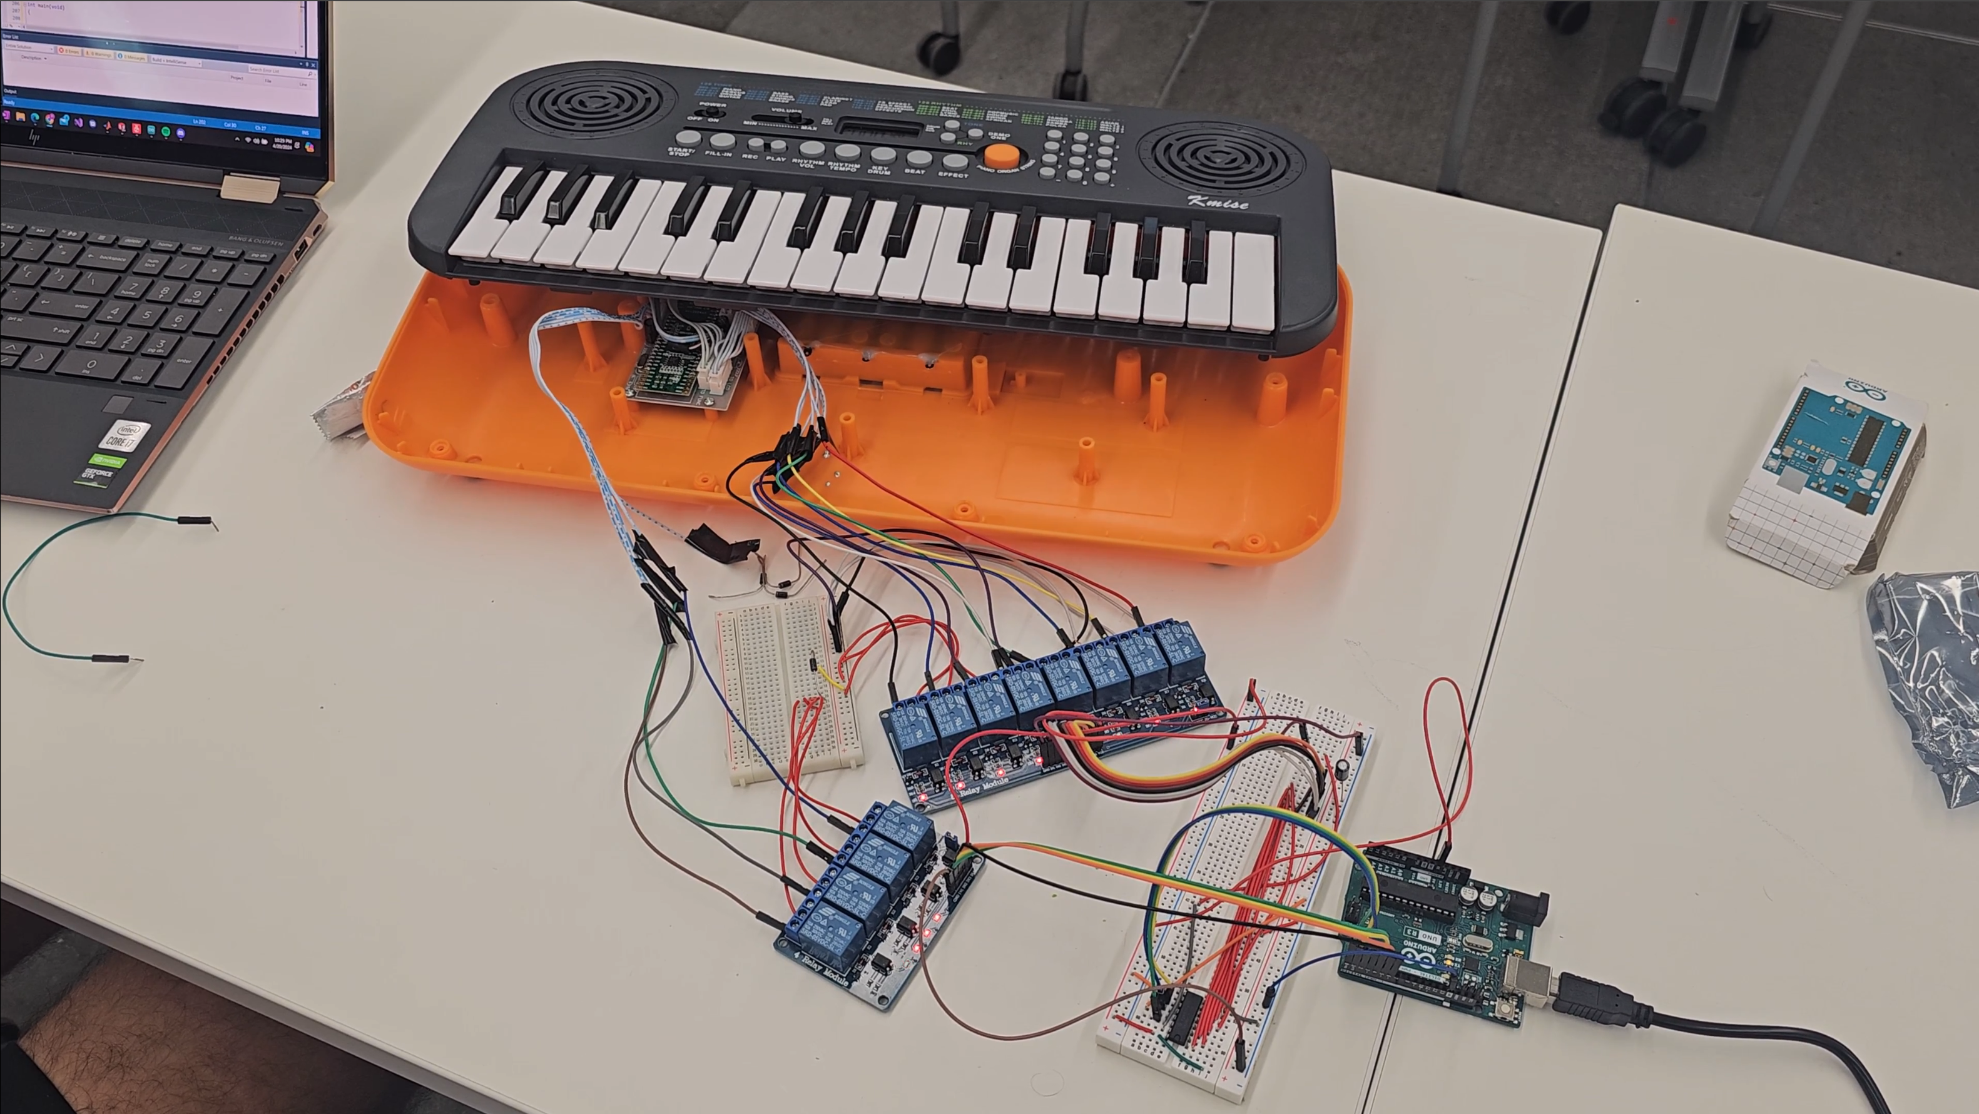
Prototype Testing

Slide 26
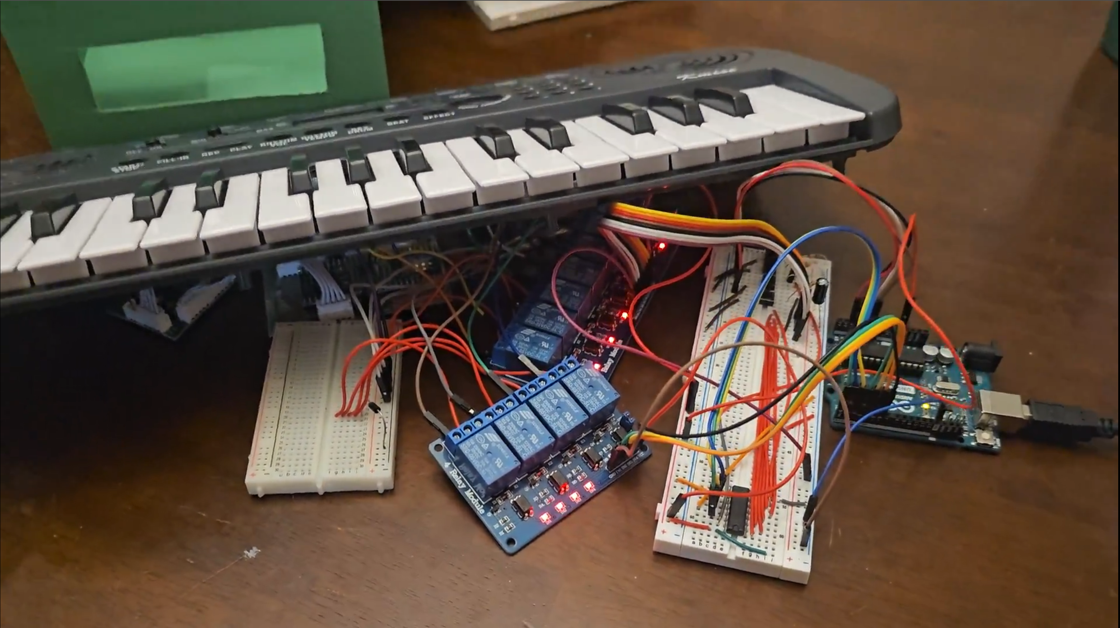
Prototype Testing 2

Slide 27
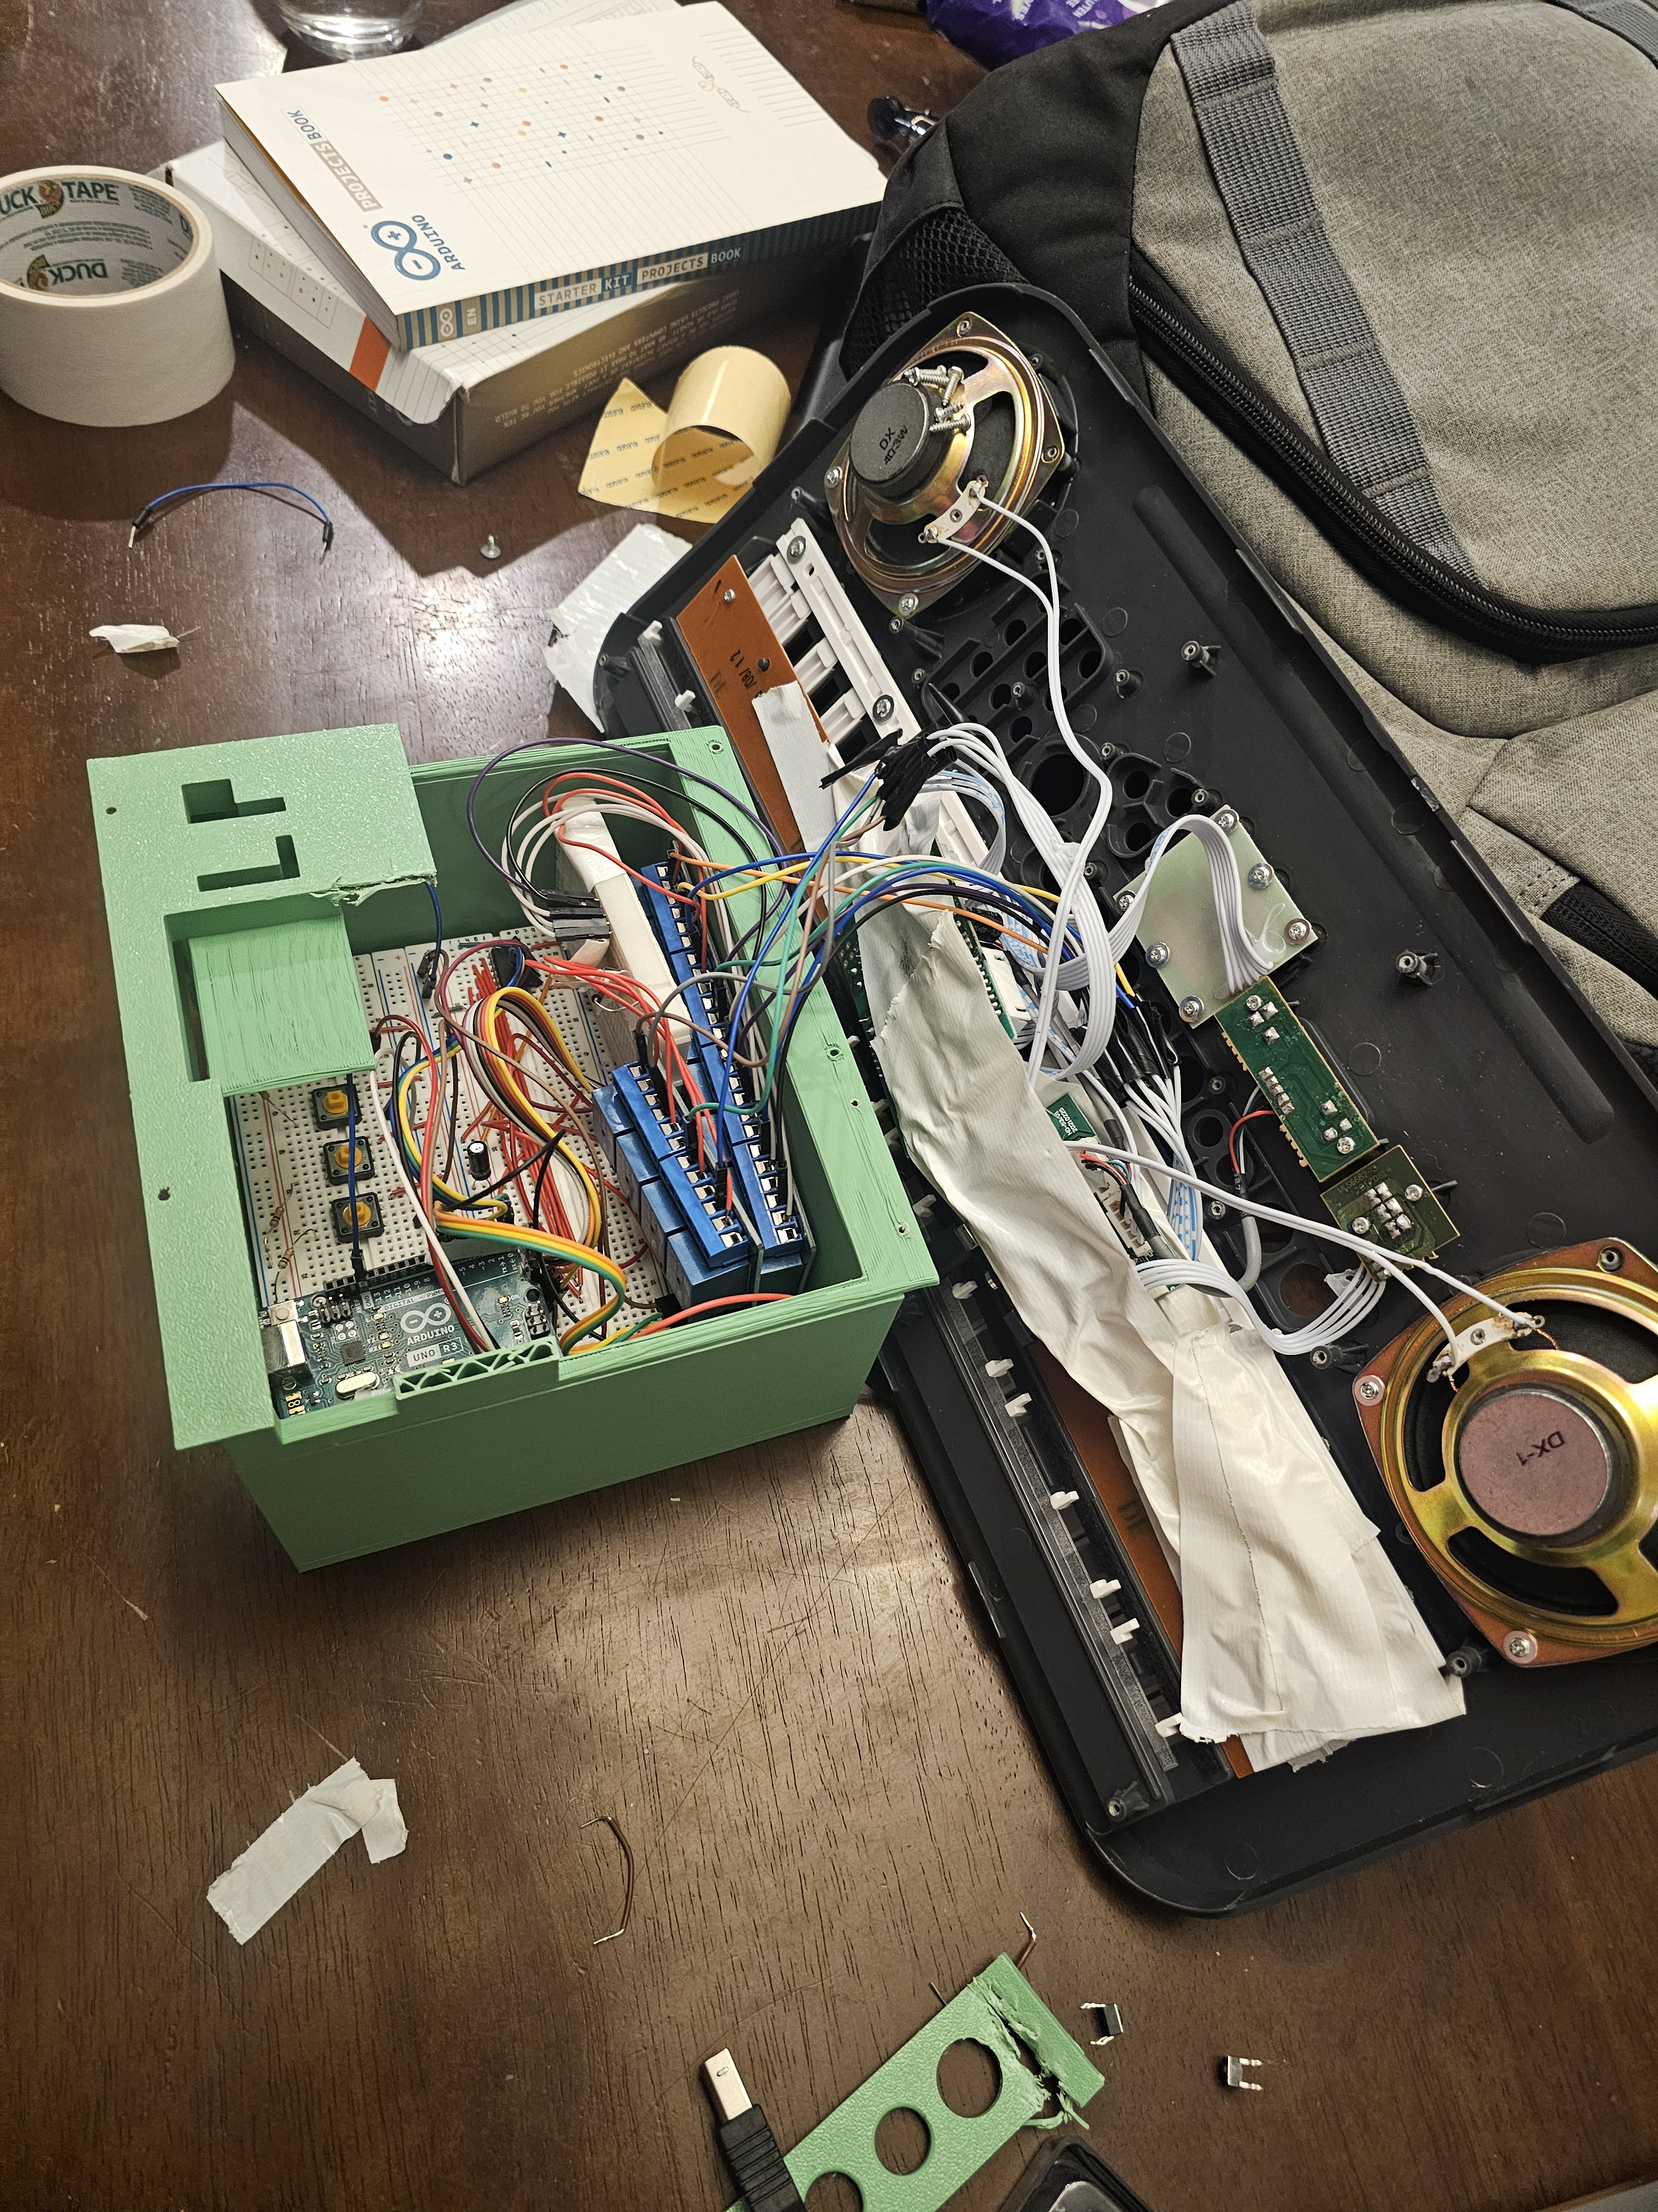

Slide 28
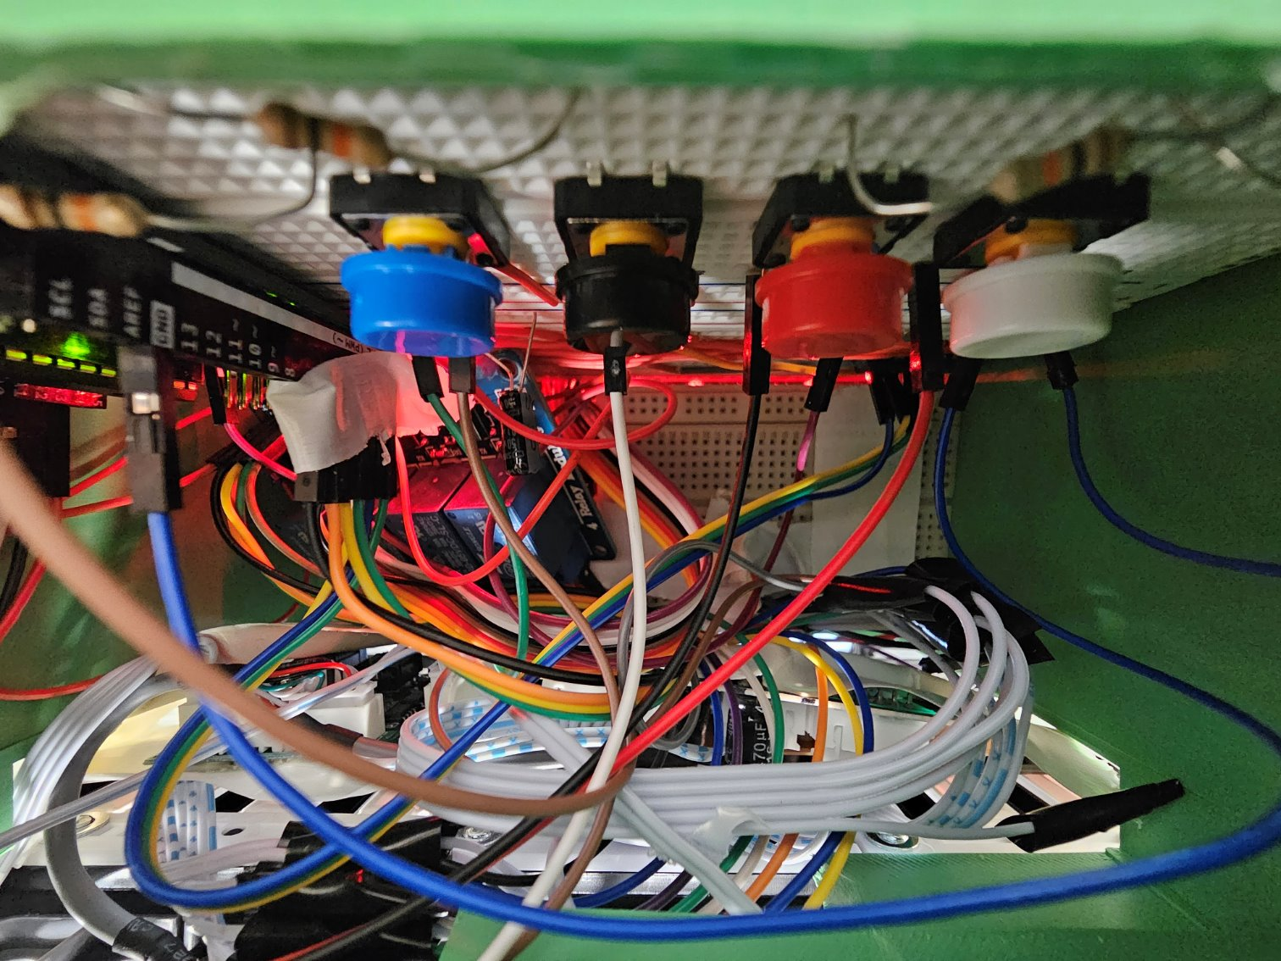

Slide 29
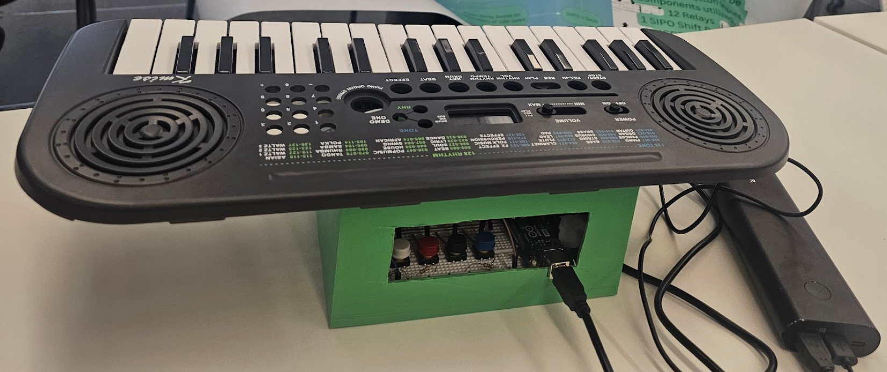
The Finalized Product

Slide 30
